Slide 1
Crop Production Analysis
Borra Vasavi
Hasmitha D K

Slide 2
Contents
Introduction
Objectives
Scope of Work
Methodology
Prediction of Crop Production Analysis
Tools and Technologies
Expected Outcomes
Timeline
Conclusion

Slide 3
Introduction
The document is an exploratory data analysis on crop production in India, utilizing a dataset from Kaggle. The analysis aims to uncover insights regarding crop yield trends, state-wise production, seasonality, and the performance of different crops over the years. Tools like Python libraries (NumPy, Pandas, Matplotlib, and Seaborn) are used for data cleaning, visualization, and exploratory analysis to answer key questions related to agricultural productivity.

Slide 4
Objectives
The main objective of the project is to analyze agricultural crop production data in India to:
Understand the distribution and yield of various crops.
Identify which states and regions have higher production.
Discover trends over time related to crop production.
Investigate the seasonality of crops and their contribution to total production.

Slide 5
Scope of Work
Data Exploration: Understanding the dataset, including crop types, production, and geographical distribution.
Data Preprocessing: Cleaning the dataset by handling missing values, addressing outliers, and preparing data for analysis.
Feature Selection: Identifying the most significant factors affecting crop production, such as region, season, and crop type.
Data Visualization: Using plots and graphs to visualize trends in crop production across states, years, and seasons.

Slide 6
Conti…
Model Building: Developing and evaluating machine learning models to predict crop production and analyze influential factors.
Interpretation of Results: Analyzing the model outputs to derive insights and draw conclusions about crop yield trends.
Reporting: Documenting the findings and preparing a comprehensive report with actionable insights for improving agricultural practices.

Slide 7
Methodology
Data Collection:
* The dataset will be sourced from a public repository, such as GitHub[crop_production.csv].
Data Preprocessing:
* Handle missing data using imputation techniques.
* Detect and remove outliers.
Exploratory Data Analysis (EDA):
* Use descriptive statistics to summarize the dataset.
* Create visualizations like line charts, box plots, and correlation heatmaps to understand feature distributions and relationships.

Slide 8
Cont…
Feature Selection:
* Use correlation analysis to identify relevant features.
Modelling:
* Split the data into training and testing sets.
* Train multiple models (e.g. Random Forest Regressor)
Evaluation and Interpretation:
* Evaluate the model’s performance using Mean Absolute Error (MAE) and Root Mean Square Error (RMSE).
* Compare model performance.

Slide 9
Cont…
Visualization:
* Generate charts and graphs to visualize the findings.
Reporting:
* Compile the analysis, results, and insights into a comprehensive report.

Slide 10
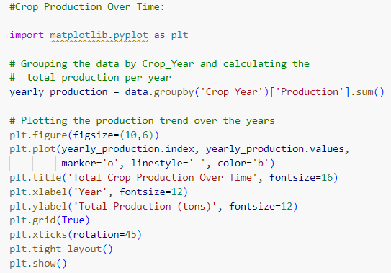
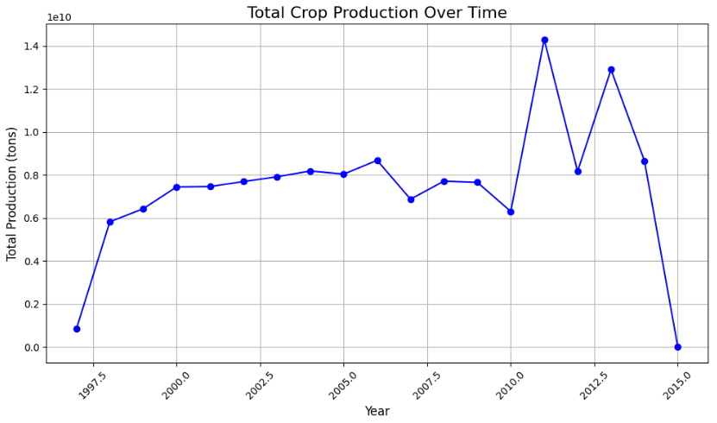
Trend Analysis
Code
Output

Slide 11
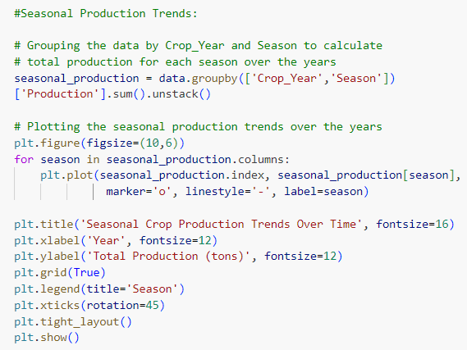
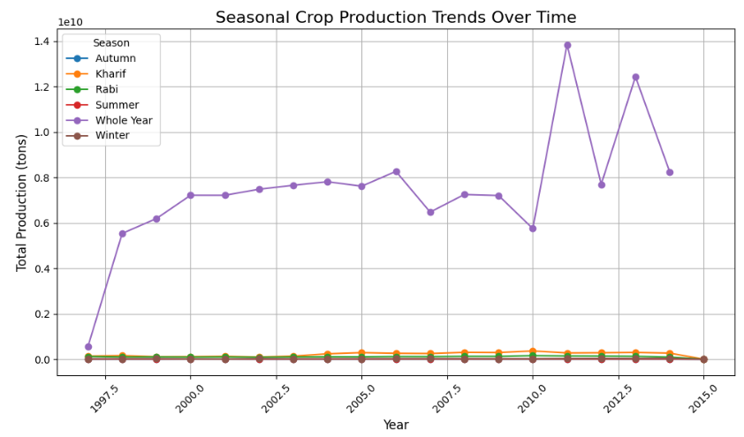
Trend Analysis
Code
Output

Slide 12
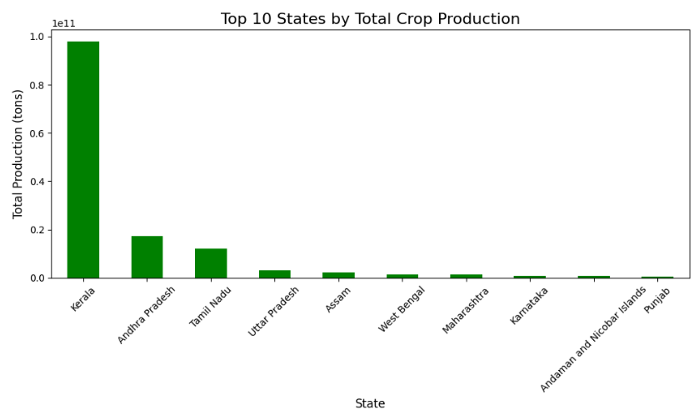
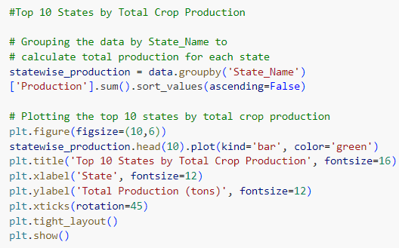
Geographical Analysis
Code
Output

Slide 13
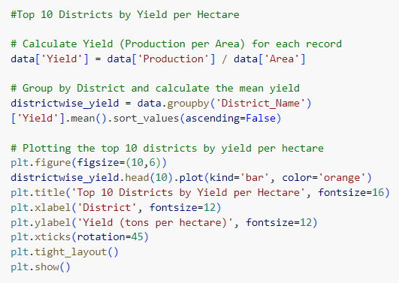
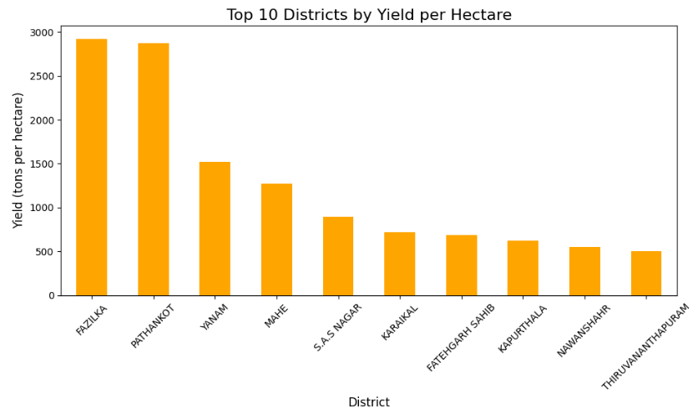
Yield Analysis
Code
Output

Slide 14
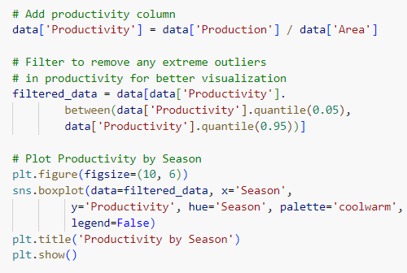
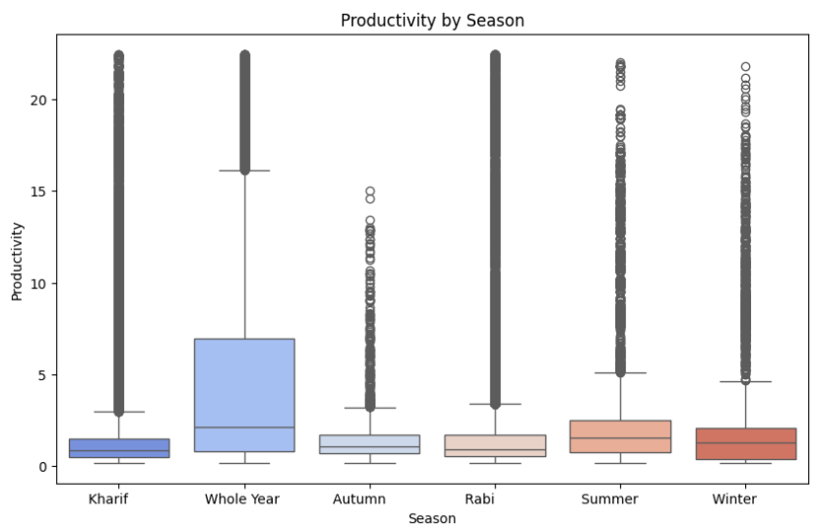
Productivity Analysis
Code
Output

Slide 15
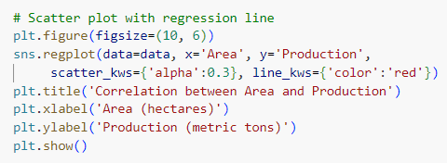
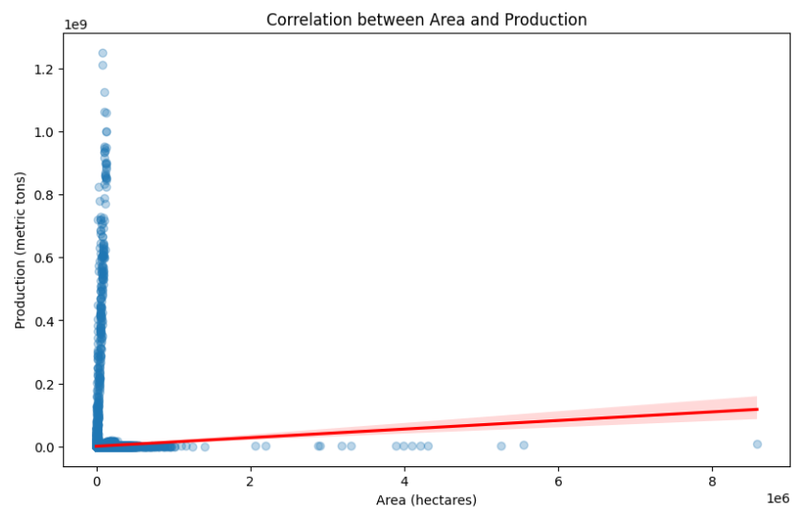
Correlation Analysis
Code
Output

Slide 16

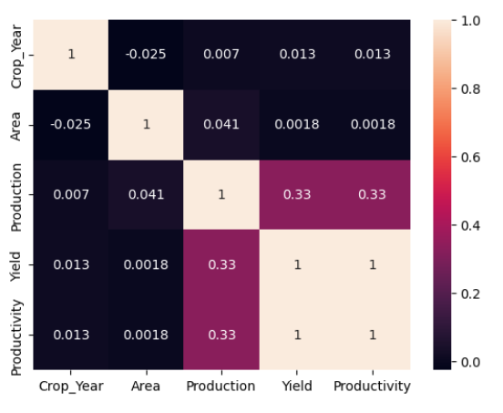
Checking for Correlation between Variables
Code
Output

Slide 17
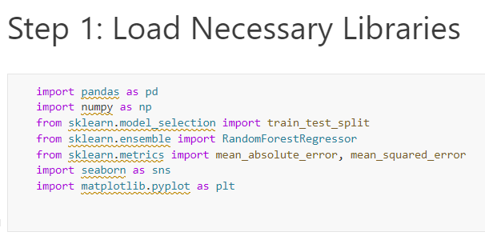
Prediction of Crop Production Analysis

Slide 18
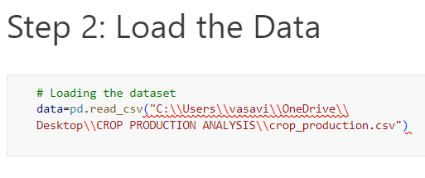
Cont…

Slide 19
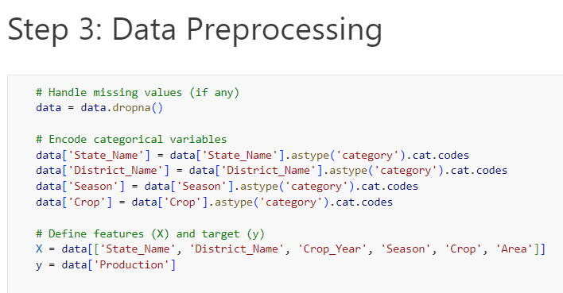
Cont…

Slide 20
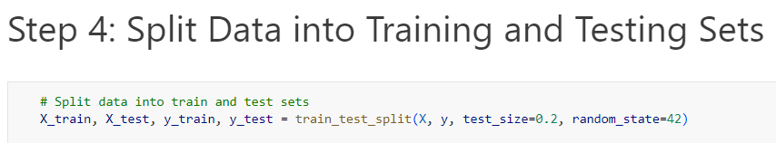
Cont…

Slide 21
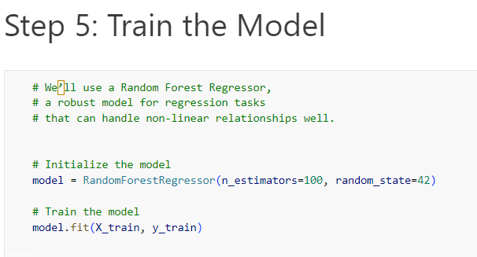
Cont…

Slide 22
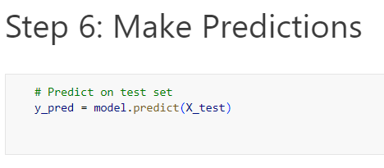
Cont…

Slide 23
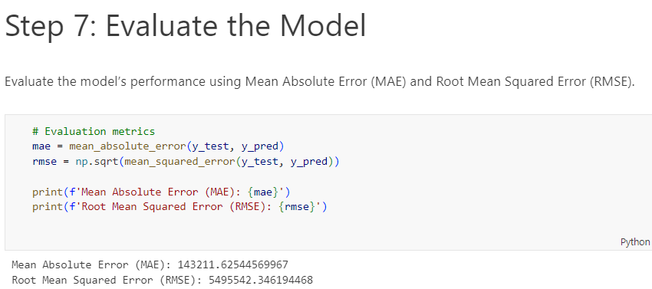
Cont…

Slide 24
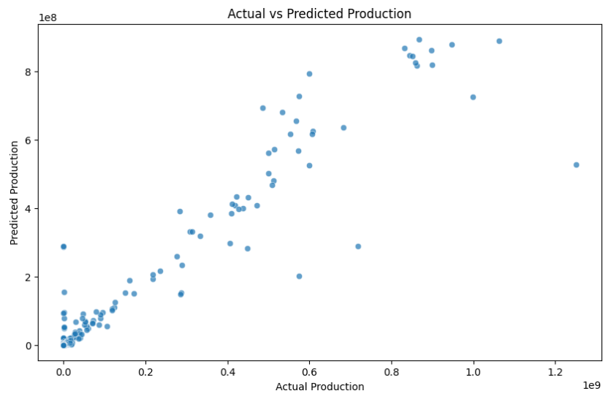
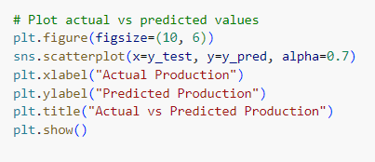
Visualize Results
Code
Output

Slide 25
Tools and Technologies
Programming Language: Python
Libraries: Pandas, NumPy, Matplotlib, Seaborn, Scikit-learn
IDE: Jupyter Notebook
Data Source: GitHub [crop_production.csv]

Slide 26
Expected Outcomes
Determine long-term trends in crop production, identifying which crops show growth or decline over the years.
Pinpoint the most productive regions for each crop, helping to identify high-yield areas and those needing support.
Assess how different seasons affect crop yields, guiding planting schedules for maximum productivity.

Slide 27
Cont…
Analyze the link between land area and yield to identify crops with high production per unit area, optimizing land usage.
Identify the highest-yielding crops overall, helping prioritize them for investment and development.

Slide 28
Timeline
The project is expected to be completed within a [specific timeframe, e.g., 4 weeks], with the following milestones:
Week 1: Data Collection and Preprocessing
Week 2: Exploratory Data Analysis and Feature Selection
Week 3: Model Building and Evaluation
Week 4: Visualization, Reporting, and Final Submission

Slide 29
Conclusion
In conclusion, crop production analysis reveals valuable insights into regional and seasonal variations, optimal growth periods, and yield trends over time. By identifying high-yield areas and efficient land-use opportunities, the analysis highlights where targeted support and tailored practices can enhance productivity. This data-driven approach not only aids yield forecasting but also empowers strategic decisions that improve crop yield, sustainability, and resilience to external influences such as climate change and market dynamics.

Slide 30
Thank You

